Slide 1


xx – CSS 3
Design revolution
Notes:
© SUPINFO International University - http://www.supinfo.com
SUPINFO vous permet de partager ce document
Vous êtes libre de :
Partager — reproduire, distribuer et communiquer ce document Remixer — modifier ce document
A condition de respecter les règles suivantes :
Indication obligatoire de la paternité — Vous devez obligatoirement préciser l’origine « SUPINFO » du document au début de celui-ci de la même manière qu’indiqué par SUPINFO International University – Notamment en laissant obligatoirement la première et la dernière page du document, mais pas d'une manière qui suggérerait que SUPINFO International University vous soutiennent ou approuvent votre utilisation du document, surtout si vous le modifiez. Dans ce dernier cas, il vous faudra obligatoirement supprimer le texte « SUPINFO Official Document » en tête de page et préciser notamment la page indiquant votre identité et les modifications principales apportées.
En dehors de ces dispositions, aucune autre modification de la première et de la dernière page du document n’est autorisée.
NOTE IMPORTANTE : Ce document est mis à disposition selon le contrat CC-BY-NC-SA Creative Commons disponible en ligne http://creativecommons.org/licenses ou par courrier postal à Creative Commons, 171 Second Street, Suite 300, San Francisco, California 94105, USA modifié en ce sens que la première et la dernière page du document ne peuvent être supprimées en cas de reproduction, distribution, communication ou modification. Vous pouvez donc reproduire, remixer, arranger et adapter ce document à des fins non commerciales tant que vous respectez les règles de paternité et que les nouveaux documents sont protégés selon des termes identiques. Les autorisations au-delà du champ de cette licence peuvent être obtenues à support@supinfo.com.
© SUPINFO International University – EDUCINVEST - Rue Ducale, 29 - 1000 Brussels Belgium . www.supinfo.com

Slide 2

Course objectives
CSS 3
By following this course, you will be able to:
Enumerate CSS3 attributes
Do media queries
Explain namespaces concept
Use level 3 selectors
Manipulate LESS framework

Slide 3


Course plan
CSS 3
Introduction
Attributes
Media queries
Namespaces
Selectors level 3
LESS framework

Slide 4
Introduction
CSS 3

Slide 5


Overview
Introduction
CSS3 is part of HTML5 specification
Probably fully usable in 2022
Developped by W3C and WHATWG
At the moment, partially implemented by browsers

Slide 6
Todo add wonderful stuff

Slide 7
Attributes
CSS 3

Slide 8

Presentation
Attributes
Since CSS 3, new attributes are usable
Can be sorted in four categories
Containers
Backgrounds
Texts
Transforms
We’ll discover them now!

Slide 9

Browser Compatibility
Attributes
Be careful: CSS3 support is still in progress!
Depending on your browser, you might have to prefix attributes by the vendor specific code:
Browser | Property scheme
Internet Explorer | -ms-propertyName
Opera | -o-propertyName
Konqueror | -khtml-propertyName
Gecko based | -moz-propertyName
Webkit based | -webkit-propertyName

Slide 10


Containers
Attributes
Box-Shadow:
Set a shadow on blocks
border-radius: left top size color;
div { box-shadow: 4px 4px 2px #AAA; }

Slide 11

Containers
Attributes
Box-sizing:
Allow to override default width and height calculation
box-sizing: type-box;
Where type-box can be:
border-box
padding-box
content-box

Slide 12
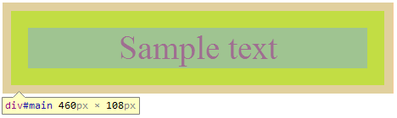
Containers
Attributes
Box-sizing:
Example with content-box:
div {
box-sizing: content-box; padding: 20px;
border:10px solid #AAA; width: 400px;
/* Actual width is 460px (400 + 20*2 + 10*2) */
}

Slide 13
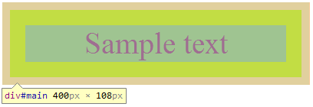
Containers
Attributes
Box-sizing:
Example with border-box:
div {
box-sizing: border-box; padding: 20px;
border:10px solid #AAA; width: 400px;
/* Actual width is now 400px */
}

Slide 14

Containers
Attributes
Border-Radius:
Round corners
border-radius: top-left top-right bottom-right bottom-left;
div { border-radius: 10px 5px 20px 0; }

Slide 15

Containers
Attributes
Border-Image:
Renders a border based on a specific image
border-image: url size x-mode y-mode;
div { border-image: url('css3.png') 20% repeat repeat; }

Slide 16


Backgrounds
Attributes
Background-Origin:
Change the default origin for background images
div {
background-origin:
border-box;
}
div {
background-origin:
padding-box;
}
Notes:
Given : div { background-image: url('css3.png'); border: 10px solid #AAA; padding: 20px; }

Slide 17
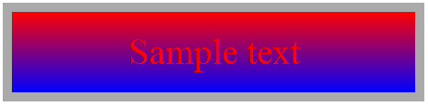
Backgrounds
Attributes
Linear-Gradient:
Advanced gradient tool
background: -vendor-linear-gradient(color1, color2 [,colorN])
div { background: -webkit-linear-gradient(red, blue) }
Notes:
More info on http://www.webkit.org/blog/1424/css3-gradients/

Slide 18

Backgrounds
Attributes
Radial-Gradient:
Advanced gradient tool
background: -vendor-radial-gradient(circle, color1, color2);
div { background: -webkit-radial-gradient(circle, red, blue) }
Notes:
More info on http://www.webkit.org/blog/1424/css3-gradients/

Slide 19
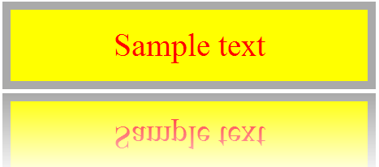
Backgrounds
Attributes
Box-Reflect:
Show a reflection effect on the target
-vendor-box-reflect: direction margin mask-box;
div {-webkit-box-reflect: below 5px
-webkit-linear-gradient(transparent, white);}
Notes:
Other example on : http://stuntsnippets.com/css3-reflection/

Slide 20

Texts
Attributes
Text-Shadow:
Set a shadow on texts
text-shadow: right top size color;
span { text-shadow: 4px 4px 2px #AAA; }

Slide 21

Texts
Attributes
Text-Stroke:
Define a color wrap around texts
text-stroke: size color;
span { text-stroke: 2px black; }

Slide 22
Texts
Attributes
Now you can set columns to blocks!
Use these three properties:
Column-count:
Splits entire text by specified number
Column-gap
Sets margins between each column
Column-width
Specifies each column width

Slide 23
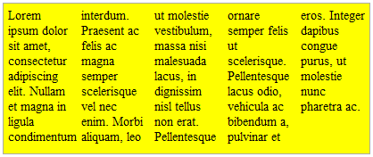
Texts
Attributes
Columns example:
column-count: number;
column-gap: gap;
column-width: width;
Usage:
div {
column-count: 5;
column-gap: 10px;
column-width: 40px;
}

Slide 24
Transforms
Attributes
Many transformations handled by the transform attribute
Scale
Rotate
Translate
We’ll see all the left ones
Matrix
Perspective
Skew

Slide 25

Transforms
Attributes
ScaleX/Y/Z:
Increase or reduce the element’s dimensions
scaleX(number); scaleY(number); scaleZ(number);
div { -webkit-transform: scaleX(2); }

Slide 26

Transforms
Attributes
RotateX/Y/Z:
Perform a rotation
rotateX(Ndeg); rotateY(Ndeg); rotateZ(Ndeg);
div { -webkit-transform: rotateY(45deg); }

Slide 27

Transforms
Attributes
TranslateX/Y/Z:
Push the element in the specified direction
translateX(Ndeg); translateY(Ndeg); translateZ(Ndeg);
div { -webkit-transform: translateX(-50px); }

Slide 28


Questions ?

Slide 29

Media Queries
CSS 3

Slide 30
Presentation
Media Queries
Handle CSS declarations depending on media used
Computers
Tablets
Smartphones
…
Two ways to use it

Slide 31
Presentation
Media Queries
In the stylesheet link:
In CSS file directly:
<link rel="stylesheet"
media="screen and (max-width: 600px)"
href="small.css" />
@media screen and (max-width: 600px) {
/* classic CSS here */
}

Slide 32
Media Types
Media Queries
Ten types defined suitable for all displays:
Media type | Usage
All | Suitable for all displays
Screen | Classical computer screen
Speech | Speech synthesizers
Tty | Terminals
Tv | Television devices
Notes:
Note : These types exist since CSS 2

Slide 33
Media Types
Media Queries
Ten types defined suitable for all displays:
Media type | Usage
Projection | Suitable for projectors
Braille | Braille tactile feedback devices.
Embossed | Paged braille printers
Handheld | Small screen / limited bandwidth
Print | Print preview mode (Ctrl + P on browser)
Notes:
Note : These types exist since CSS 2

Slide 34
Min-Width / Max-Width
Media Queries
Max-Width:
Useful for high resolution display:
Min-Width:
Mostly smartphone related:
@media screen and (max-width: 1900px) {
#container { width: 1500px; }
}
@media screen and (min-width: 600px) {
#print-button { display: none; }
}

Slide 35
Max-Device-Width
Media Queries
Min-width and max-width stands for resolution dedicated to browser (eg. window size)
Max-device-width is related to screen resolution
@media screen and (max-device-width: 600px) {
#footer { padding: 0; }
}

Slide 36
Combining media queries
Media Queries
Operator « and » can combine them!
Already seen on previous slides
Operator « , » can associate combinations
@media screen and (max-width: 23em) {}
@media handheld and (min-width: 20em), screen and (min-width: 20em){}

Slide 37
Combining media queries
Media Queries
Some keywords must be placed in braces:
Used if the screen can render colors:
Operator « not » discard style inclusion if prerequisites are matched:
Not used if the media used is the print preview:
@media screen and (color) {}
@media not print and (color) {}

Slide 38
Additional informations
Media Queries
Useful media queries:
Final note: At the time of this writing Internet Explorer simply doesn’t support media queries.
Media query | Device
all and (max-device-width: 480px) | iPhone
all and (orientation: portrait) | Smartphones and tablet in portrait
all and (orientation: landscape) | Smartphones and tablet in landscape

Slide 39
Questions ?

Slide 40

Namespaces
CSS 3

Slide 41
Presentation
Namespaces
Remember the XML attribute « xmlns » ?
Allows to define namespaces
CSS 3 can style XML elements depending on their respective namespaces
We’ll see how in this chapter ☺

Slide 42
XML namespaces
Namespaces
An XML namespace is set by its attribute « xmlns »
The namespace will be declared until the closing tag
Usually all namespaces are set in the first tag
<Enterprise xmlns="http://www.ns.com/ns/Enterprise">
<Enterprise xmlns="http://www.ns.com/ns/Enterprise"
xmlns:manager="http://www.ns.com/ns/Manager"
xmlns:employee="http://www.ns.com/ns/Employee">

Slide 43
Include CSS in XML
Namespaces
Remember the doctype used for XML?
Right after it, include your stylesheet like this:
<?xml version="1.0" encoding="UTF-8" ?>
<?xml-stylesheet type="text/css" href="ns-style.css" ?>

Slide 44
XML namespace syntax
Namespaces
How to include a specific tag in a namespace?
<namespace:theTag> </namespace:theTag>
Non-prefixed tag belongs to the main namespace
<manager:Manager>Manager stuff</manager:Manager>
<info>Some unrelated informations</info>

Slide 45
<?xml version="1.0" encoding="UTF-8" ?>
<?xml-stylesheet type="text/css" href="ns-style.css" ?>
<Enterprise xmlns="http://www.ns.com/ns/Enterprise"
xmlns:manager="http://www.ns.com/ns/Manager"
xmlns:employee="http://www.ns.com/ns/Employee">
<manager:Manager>
<manager:FirstName>Barney</manager:FirstName>
<manager:LastName>Stinson</manager:LastName>
</manager:Manager>
<employee:Employee>
<employee:FirstName>John</employee:FirstName>
<employee:LastName>Doe</employee:LastName>
</employee:Employee>
<info>Description of the enterprise</info>
</Enterprise>
Complete XML example

Slide 46
What about CSS?
Namespaces
In CSS, define your namespaces as follows:
CSS namespaces are linked to XML namespaces thanks to the URL provided in both files:
In this example, root CSS namespace will concern all tags with the « Enterprise » namespace.
@namespace url("http://www.ns.com/ns/Enterprise");
@namespace manager url("http://www.ns.com/ns/Manager");
@namespace employee url("http://www.ns.com/ns/Employee");

Slide 47
What about CSS?
Namespaces
After namespaces declaration, use it!
Selector | Target
ns|a | Represents tag a in the namespace ns
|b | Represents tag b that belongs to no namespace
*|c | Represents tag c in any namespace
d | Represents tag d in the root namespace (as classical CSS)
manager|Manager { color: red; }
Enterprise employee|FirstName { color: green; }
*|LastName { font-weight: bold; }

Slide 48

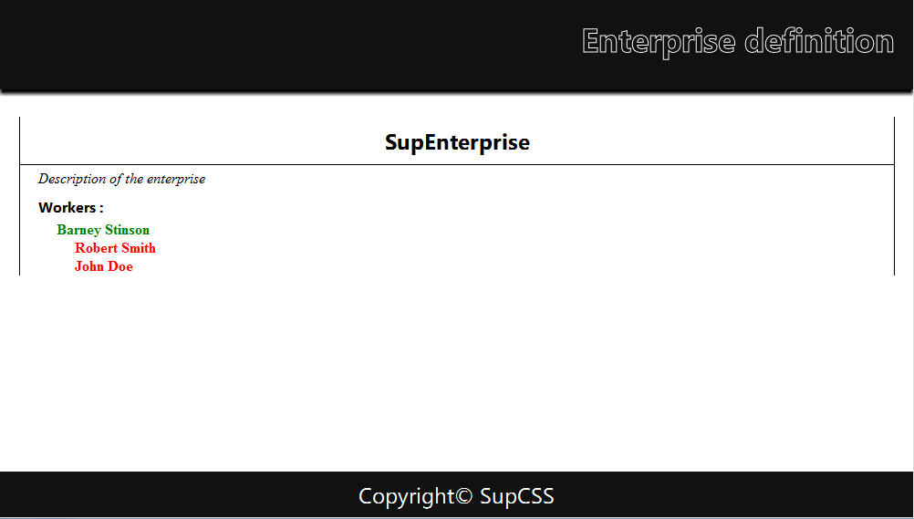
Xml Rendering
Namespaces
Now you can style XML as easily as HTML!

Slide 49
Questions ?

Slide 50

Selectors level 3
CSS 3

Slide 51
Why new selectors?
Selectors level 3
CSS 2 uses some specific selectors which targets specific HTML elements
Also available in CSS 3!
Several manipulations were impossible before
Target odd or even rows in a table
Find all disabled elements
Use regular expressions on attributes
…

Slide 52
What is new?
Selectors level 3
New selectors (1 of 3):
Selector | Targetting
E[foo^="bar"] | An E element whose "foo" attribute value begins with "bar"
E[foo$="bar"] | An E element whose "foo" attribute value ends with "bar"
E[foo*="bar"] | An E element whose "foo" attribute value contains the substring "bar"
E:root | An E element, root of the document
E ~ F | An F element preceded by an E element
Notes:
Besides the root element of an HTML document is « html », it’s not the case in XML based document !
E:root can be useful in some cases (define a layout no matter which XML is sent to the client)

Slide 53
What is new?
Selectors level 3
New selectors (2 of 3):
Selector | Targetting
E:nth-child(n) E:nth-last-child(n) | An E element, the n-th child of its parent …counting from the last
E:nth-of-type(n) E:nth-last-of-type(n) | An E element,the n-th sibling of its type …counting from the last
E:first-child E:last-child | An E element, first child of its parent … counting from the last
Notes:
More info on nth* selectors here : http://www.w3.org/wiki/CSS/Selectors/pseudo-classes/:nth-child

Slide 54
What is new?
Selectors level 3
New selectors (3 of 3):
Selector | Targetting
E:empty | An E element that has no children (including text nodes)
E:target | An E element targetted by the referring URI (#anchor)
E:enabled E:disabled | An E element which is enabled …or disabled
E:checked | An UI element E which is checked (radio button, checkbox)
E:not(s) | An E element that does not match the simple selector s
Notes:
More information on E:target here : http://webdesignernotebook.com/css/the-css3-target-pseudo-class-and-css-animations/

Slide 55
Questions ?

Slide 56

Less CSS
CSS 3

Slide 57
Overview
Less CSS
Dynamic stylesheet language (CSS preprocessor)
Don’t confuse with LESS framework!
LessCSS extends CSS with dynamic behavior
LessFramework allows to design pages easily (bootstrap)
Documentation findable here: http://lesscss.org/

Slide 58
Overview
Less CSS
Open source
Written first in Ruby
Ruby replaced by JavaScript in later versions
Syntax very close to classical CSS
CSS file is a valid Less file

Slide 59
Overview
Less CSS
Can be used in a website in two ways:
By a local compiler who transcripts Less files in CSS files
By uploading Less files and using a JavaScript adapter who converts the code on the fly
Similar projects:
Sass
Zuss

Slide 60

Advantages
Less CSS
Less redundant code
More readable
Thanks to nesting
Advanced concepts:
Variables
Functions
Operations
…

Slide 61
Install
Less CSS
Stylesheet inclusion:
JavaScript adapter inclusion:
<link rel="stylesheet/less" type="text/css" href="styles.less">
<script src="less.js" type="text/javascript"></script>
Notes:
http://lesscss.org/#-client-side-usage

Slide 62
Nesting
Less CSS
Less CSS
Generated CSS
#header {
h1 {
font-size: 26px;
}
a {
text-decoration: none;
&:hover {
color: black;
}
}
}
#header h1 {
font-size: 26px;
}
#header a {
text-decoration: none;
}
#header a:hover {
color: black;
}

Slide 63
Variables
Less CSS
Less CSS
Generated CSS
@main-color: #FFDEAD;
#header {
h1 {
color: @main-color;
}
}
#container {
border-left: 1px solid
@main-color;
border-right: 1px solid
@main-color;
}
#header h1 {
color: #FFDEAD;
}
#container {
border-left: 1px solid
#FFDEAD;
border-right: 1px solid
#FFDEAD;
}

Slide 64
Operations
Less CSS
Less CSS
Generated CSS
@border-width: 1px;
@dark-gray: #111;
#header {
color: @dark-gray * 3;
}
#container {
border: @border-width*2 solid
@dark-gray;
color: (@dark-gray + #111)*4;
}
#header {
color: #333;
}
#container {
border: 2px solid #111; color: #888;
}

Slide 65
Mixins
Less CSS
Less CSS
Generated CSS
.rounded-corners {
border-radius: 5px;
-moz-border-radius: 5px;
-webkit-border-radius: 5px;
}
#header {
.rounded-corners;
}
#container {
.rounded-corners;
}
#header, #container,
.rounded-corners {
border-radius: 5px;
-moz-border-radius: 5px;
-webkit-border-radius: 5px;
}

Slide 66
Mixins with parameters
Less CSS
Less CSS
.rounded-corners(@size) {
border-radius: @size;
-moz-border-radius: @size;
-webkit-border-radius: @size;
}
.border-base(@color: black, @size: 1px) {
border: @size solid @color;
}
#container {
.rounded-corners(5px);
.border-base(#333);
}

Slide 67
Mixins with parameters
Less CSS
Generated CSS
Is it really like functions in other languages?
#container {
border-radius: 5px;
-moz-border-radius: 5px;
-webkit-border-radius: 5px;
border: 1px solid #333;
}

Slide 68
Mixins overloading
Less CSS
Less CSS
Generated CSS
.grady(@a) {
color: @a;
}
.grady(@a, @b) {
color: fade(@a, @b);
}
#container { .grady(#555); }
#footer { .grady(black, 50%); }
#container {
color: #555;
}
#footer {
color: rgba(0, 0, 0, 0.5);
}

Slide 69
Built-in functions - Color
Less CSS
Color changing functions (1 of 2):
Decline your entire layout by only two colors!
Example | Champ 2
lighten(@color, 10%); | Return a color 10% lighter than @color
darken(@color, 10%); | Return a color 10% darker than @color
saturate(@color, 10%); | Return a color 10% more saturated than @color
desaturate(@color, 10%); | Return a color 10% less saturated than @color
mix(@color1, @color2); | Return a mix of @color1 and @color2

Slide 70
Built-in functions - Color
Less CSS
Color changing functions (2 of 2):
Decline your entire layout by only two colors!
Example | Champ 2
fadein(@color, 10%); | Return a color 10% less transparent than @color
fadeout(@color, 10%); | Return a color 10% more transparent than @color
fade(@color, 50%); | Return @color with 50% transparency
spin(@color, 10); | Return a color 10 degree larger in hue than @color
spin(@color, -10); | Return return a color 10 degree smaller hue than @color

Slide 71
Conditional statements
Less CSS
Less CSS handles conditions!
Begins with « when »
Optionnaly followed by « and », « , » (logical OR), « not »
.fontcolor(@bg-opacity) when (@bg-opacity =< 0.5) {
color: black;
}
.fontcolor(@bg-opacity) when (@bg-opacity > 0.5) {
color: white;
}
#container { opacity: 0.5; .fontcolor(0.5) ; }

Slide 72

Conditional statements
Less CSS
Five operators:
>=
>
=
<
<=
Only dimension and keywords are comparable

Slide 73
Built-in functions - Conditions
Less CSS
iscolor
Isnumber
ispixel
ispercentage
isem
isstring
iskeyword
isurl

Slide 74
Additional informations
Less CSS
Less can be compiled and minified server side for a perfect integration with nodeJS and Rhino.
You’ll see it in the next chapter!
Note: At the time of this writing Chrome doesn’t support Less.js if the path to your page starts with "file:///".
Notes:
You can find a workaround for Chrome by using a HTTP server on your local machine (like WAMP).

Slide 75
Questions ?

Slide 76

Statistiques
Titre du chapitre
Chiffres et statistiques associés au contenu

Slide 77
Comparaison
Titre du chapitre
Exemple de comparaison
Champ 1 | Champ 2
Valeur1-A | Valeur1-B
Valeur2-A | Valeur2-B
Valeur3-A | Valeur3-B
Valeur4-A | Valeur4-B
Valeur5-A | Valeur5-B

Slide 78
Titre de la diapositive
Titre du chapitre
Texte 1
Texte 2
Texte 3
Texte 2
Texte 3
Texte …avec coloration syntaxique
Texte …avec coloration syntaxique

Slide 79

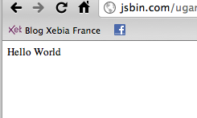
Diapo de code cours
Titre du chapitre
<html xmlns="http://www.w3.org/1999/xhtml" xml:lang="fr" >
<head>
<title>Hello World avec jQuery</title>
<meta http-equiv="Content-Type"
content="text/html; charset=iso-8859-1" />
<script type="text/javascript" src="jquery.js"></script>
</head>
<body>
Hi !
<script type="text/javascript">
$('body').html('Hello World');
</script>
</body>
</html>

Slide 80
Diapo de code multiple
Titre du chapitre
Easier syntax to navigate into a document
Simple JavaScript version :
jQuery version :
function getTextboxValue() {
var obj = document.getElementById("champ_input");
alert('Le champ a pour valeur : "' + obj.value + '"');
}
function getTextboxValue() {
alert('Le champ a pour valeur : + $("#champ_input").val());
}

Slide 81
function getScrollXY() {
var scrOfX = 0, scrOfY = 0;
if( typeof( window.pageYOffset ) == 'number' ) {
//Netscape compliant
scrOfY = window.pageYOffset;
scrOfX = window.pageXOffset;
} else if( document.body &&
(document.body.scrollLeft ||
document.body.scrollTop)) {
//DOM compliant
scrOfY = document.body.scrollTop;
scrOfX = document.body.scrollLeft;
} else if( document.documentElement &&
(document.documentElement.scrollLeft
|| document.documentElement.scrollTop)) {
//IE6 standards compliant mode
scrOfY = document.documentElement.scrollTop;
scrOfX = document.documentElement.scrollLeft;
}
return [ scrOfX, scrOfY ];
}
Diapo code complet

Slide 82
Exemple de tableau
Titre du chapitre
Texte 1
Champ 1 | Champ 2
* | All elements
element | All element elements
#id | Element with « id » as id
.class | Elements with « class » as class value
elem[attr] | Elements with « attr » attribute specified

Slide 83
Exemple de liste
Titre de chapitre
$('p');
<p> Hey, Dude ! </p>
$('div');
<div> ... </div>
$('#header');
<div id="header"> ... </div>
$('#menu');
<span id="menu"> ... </span>
$('.notice');
<span class="notice"> ... </span>
$('.error');
<span class="error"> ... </span>

Slide 84
Pause Questions/Réponses

Slide 85

Citation
Titre du chapitre
“ Always code as if the person who ends up maintaining your code is a violent psychopath who knows where you live. ”

Slide 86

Souvenez-vous
Titre du chapitre
Exemple de contenu déjà vu précédemment

Slide 87

Contenu multimédia
Titre du chapitre
Un contenu multimédia

Slide 88

Exercices
Titre du chapitre
Texte 1
Texte 2
Texte 3

Slide 89
Point important
Titre du chapitre
Texte 1
Texte 2
Texte 1
Texte 2

Slide 90

Fin du module
Titre du Powerpoint
Merci de votre attention

Slide 91

Votre Full Professor
Présentation du cours
Prénom Nom
Contact
Certifications
Parcours
Diapositive du module 00
Photo

Slide 92

Planning
Présentation du cours
Nombre d’heures
Chapitre 1 – heures
Chapitre 2 – heures
Evaluation numéro 1 le
Evaluation numéro 2 le

